Slide 1
Web Tools Project
BY VIGHNESH
001250045

Slide 2
CHOICE OF TOPIC
KETTOS
UNDERGRAD CAPSTONE PROJECT AND AED PROJECT WERE TOPICS ON SOCIAL WELFARE
WANTED TO CONTINUE IN THE SAME DOMAIN

Slide 3
DATABASE DIAGRAM

Slide 4
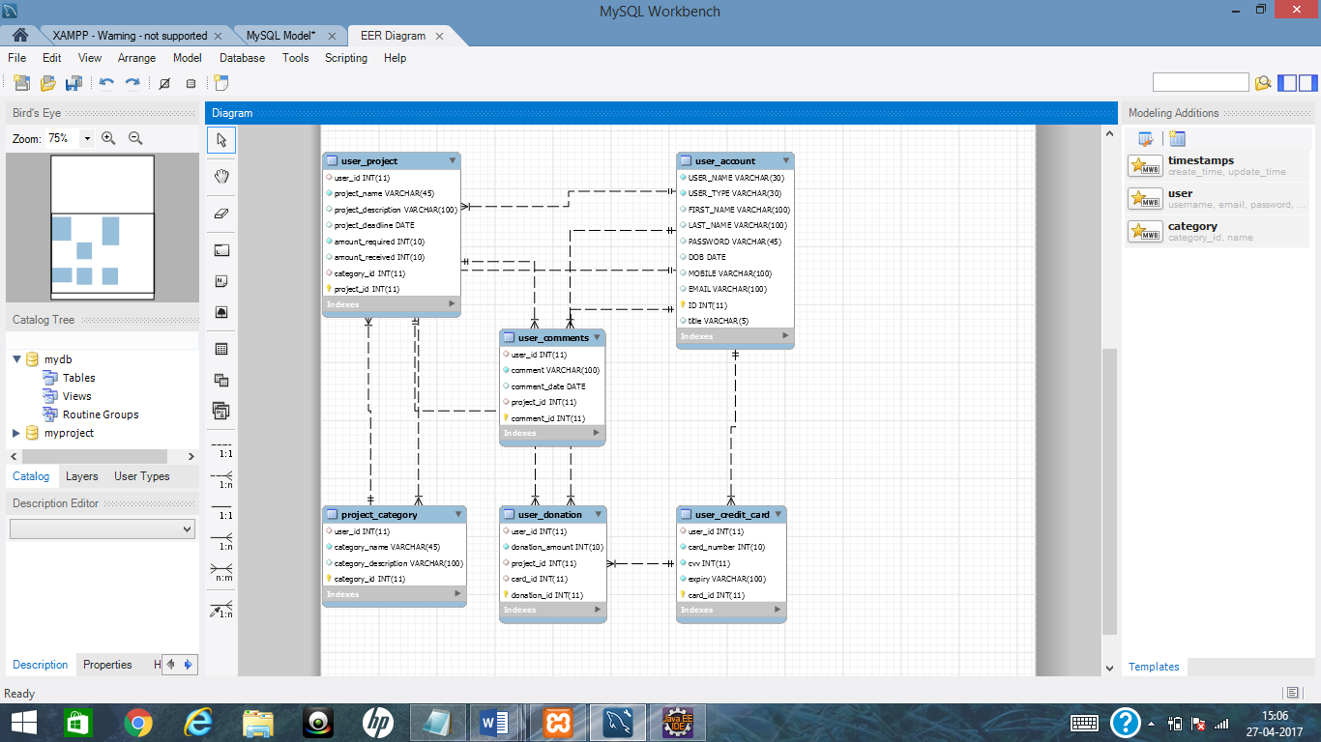

Slide 5
APPLICATION ARCHITECTURE
AngularJS (Front End)
REST (Using Model for both Capture Data and Responding)
Service (Business Logic for the application- Converting Model to Entity and reverse)
DAO (Database Access performing CRUD)
Spring Injection for (SessionFactory/Controller/Service/DAO)
Hibernate (Hibernate Mapping: hbm.xml / annotation)

Slide 6
APPLICATION FLOW

Slide 7
HOME PAGE
SHOWN ON STARTUP FOR ALL USERS
CAN VIEW A LIST OF PROJECTS
CANNOT VIEW DETAILS OF PROJECT: HAVE TO LOGIN/REGISTER

Slide 8
REGISTRATION PAGE
NEED TO REGISTER WITH A UNIQUE USERNAME IN ORDER TO LOGIN
NEED TO CHOOSE USER TYPE : CREATOR OR USER
PASSWORD IS HASHED AND STORED IN THE DATABASE

Slide 9
LOGIN PAGE
NEED TO ENTER CORRECT USERNAME AND PASSWORD CREDENTIALS
ADMIN GOES TO ADMIN DASHBOARD
CREATOR TO CREATOR DASHBOARD
DONOR TO DONOR DASHBOARD

Slide 10
ADMIN DASHBOARD
CAN CREATE CATEGORIES
CAN DELETE PROJECTS
WHEN YOU DELETE A PROJECT, CORRESPONDING DONATIONS AND COMMENTS GET DELETED AS WELL.
CAN VIEW ALL CATEGORIES AND PROJECTS

Slide 11
DONOR DASHBOARD
CAN VIEW ALL PROJECTS
CAN DONATE TO ALL PROJECTS
CAN COMMENT ON PROJECTS

Slide 12
CREATOR DASHBOARD
CAN CREATE PROJECTS
CAN VIEW ONLY HIS PROJECTS

